Slide 1

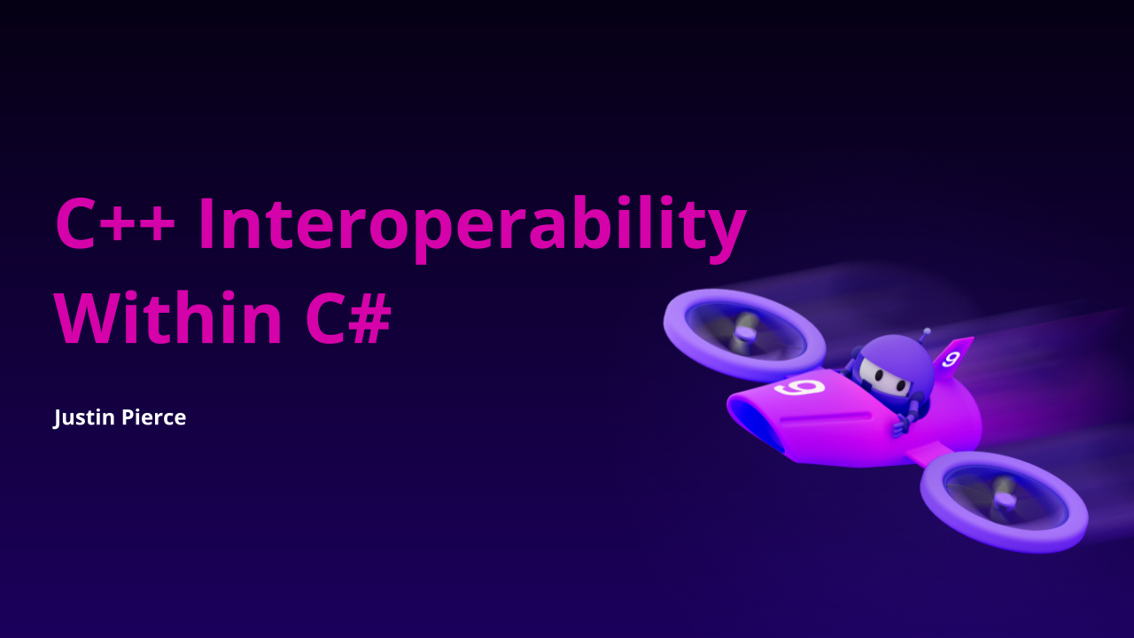

Notes:
Personal Introduction
Hi my name is Justin Pierce and I’m the lead developer of Iron Software speaking to you today from our office here in Chiang Mai, Thailand.
Topic Introduction
For the next 30 minutes we’ll be discussing how you may go about using C++ libraries within your .NET library or app. We’ll briefly touch on a few basics for those who may not be familiar with C++, and then we’ll dive into how - and why - to utilize C++ libraries in your .NET solution as well as a plethora of common pitfalls you may encounter when calling your C++ methods from C#.
NEXT SLIDE

Slide 2
Use Cases for C#/C++ Interop
Utilizing existing open source C++ libraries which lack C# bindings
High-performance real-time applications (e.g. hardware control)
Computer graphics or low-level operating system calls (OpenGL, etc.)
Leptonica (image manipulation)
OpenCV (computer vision)
OpenGL (computer graphics)
TensorFlow (machine learning)
CUDA (parallel processing)
Proprietary hardware SDKs
Platform-specific APIs
Notes:
Use Cases for C#/C++ Interop
.NET offers a lot of conveniences over C++, including automatic memory management, being platform agnostic since .NET core, and having easy and convenient syntax; including such things as LINQ expressions, interfaces, and more. I think most people would agree that C# presents a lower “barrier of entry” when compared to C++.
So in what cases might we want to integrate a C++ library into our C# library or application?
Gain access to the mountain of powerful C++ libraries out there. In some cases, these libraries may only be available in C++, so you’ll have to write your own interop wrapper from scratch. In other cases, there may be C# bindings available but you may find them lacking or out-of-date.
CLICK TO SHOW EXAMPLE LIBRARIES
(here you can see some examples of open source C++ libraries you may want to call from C#)
Another reason why you might want to call C++ methods from C# is for real-time applications, such as robotics. While low-latency applications are possible in .NET, historical precedence tends to favor native code over managed code for hardware interaction.
Finally, C++ offers low-level computer graphics APIs such as OpenGL, Vulkan, or DirectX, as well as some low-level APIs specific to your operating system or access to computer graphics interfaces.
NEXT SLIDE

Slide 3
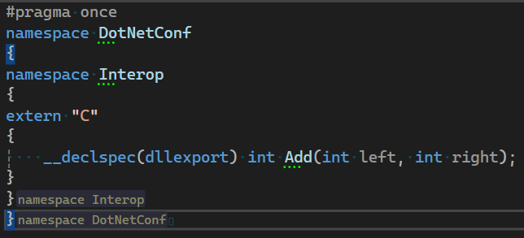
Preparing Your Native Code
Indicate to your compiler which methods you’d like to export
Generate a shared library
Make a note of the method signatures in your header file
Ensure your assembly file is discoverable
Notes:
C++ Header File First, let’s make sure we have some native C++ functions available to call from C#. This will assume some basic knowledge of C++.
CLICK TO SHOW LIST
Be sure your native assembly has some methods marked for export so that they will be visible from the C# side. This is accomplished with the `dllexport` attribute OR module definition file (.def file)
Be sure to generate a shared library (e.g. .dll, .so, .dylib) and not a static library (.lib)
Make a special note of your method signatures - you will need to declare a matching delegate in C#
Ensure your assembly file is discoverable by your C# library or application. .NET will be loading your native assemblies at runtime, so we need to be sure to deploy our native assembly along with our .NET application and to place the assembly somewhere it is easily discoverable.
(And here on the right you can see an example C++ header file which declares a very simple method which we can call from .NET)
NEXT SLIDE

Slide 4

Key Techniques
P/Invoke
C++/CLI
COM Interop
SWIG
Methods and attributes from System.Runtime.InteropServices
Notes:
Different Approaches
OK, so you’ve got your native assembly ready to go. How can we approach interacting with your valuable native methods from within .NET?
CLICK TO SHOW ARROW
P/Invoke “P/Invoke” (or “Platform Invoke”) is the bread-and-butter of C# interoperability with C++. This is a C# technology comprised of some special methods and attributes within the `System` and `System.Runtime.InteropServices` namespaces. To “P/Invoke” our native methods from managed code, we can either use C#’s `DllImport` attribute, or the more flexible `NativeLibrary` class. So let’s take a look at these approaches.
NEXT SLIDE

Slide 5
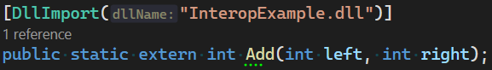
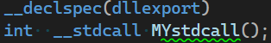
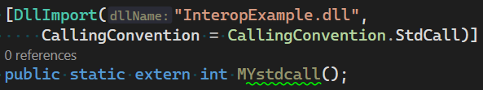
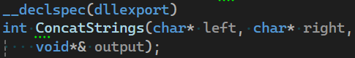
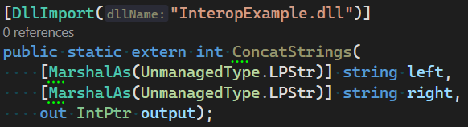
Compatible Method Signatures (Using DllImport Attribute)
C++
C#
Notes:
Method Signatures
First off, let’s look at how to use the `DllImport` attribute and some of the options available to us.
CLICK TO SHOW FIRST EXAMPLE
Our first example is a simple addition function. Not too useful in practice, but a good place to start nonetheless. Notice that when you use the `DllImport` attribute, you are limited to specifying the assembly name (and path) at compile time.
CLICK TO SHOW SECOND EXAMPLE
Our second example demonstrates how to match calling conventions, which can be relevant in specific circumstances; particularly when dealing with multiple platforms.
CLICK TO SHOW THIRD EXAMPLE
Our third example shows how we might pass some strings and retrieve a result of their concatenation. Note that we can’t just return a string from C++ to C#. (Don’t worry if this looks a bit overwhelming - we’ll make it even more complicated later on.)
The `DllImport` attribute is still widely used, but now days in .NET core we have a more modern and flexible option available with the ‘NativeLibrary’ class.
So, before we finally start running some code, let’s go take a quick look at the syntax for the ‘NativeLibrary’ class.
NEXT SLIDE

Slide 6
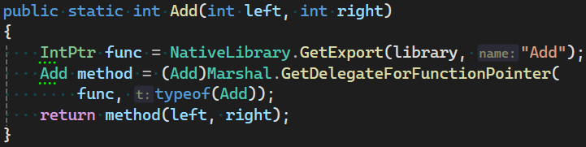
Using the NativeLibrary Class
Declare the Delegate
Load the Library
Call the Function
Notes:
Using the NativeLibrary Class
So let’s look at the `NativeLibrary` class available in .NET core.
CLICK TO SHOW FIRST STEP
First declare the delegate to match your native method. This is just like we went over in the previous slide, except now we use the `UnmanagedFunctionPointer` attribute.
CLICK TO SHOW SECOND STEP
Use the static `NativeLibrary` class to load your native assembly. Note how this is a bit more flexible than the `DllImport` attribute as it allows us to resolve the assembly path at runtime.
CLICK TO SHOW THIRD STEP
Finally, retrieve the native function pointer and cast it to your delegate so you can invoke it elsewhere in your library or application.
As you can see, this approach requires a bit more “boilerplate” code than the previous approach, but offers greater flexibility. For me, this is the preferred approach and the approach I will be using for the remainder of this presentation.
NEXT SLIDE

Slide 7
Our Console Application
Notes:
Our Console Application
OK, let’s finally dive to Visual Studio and run some code. We’ll be running a simple .NET 8.0 application which is calling various interop methods which we have defined.
CLICK TO START VIDEO
You can see here our simple interop methods within our console app… and we’re going to go ahead and hit run and see what happens.
WAIT FOR EXCEPTION
OK, it looks it ran, but we may have encountered an exception of some kind. As you can see, our first few interop methods were executed successfully, but our program threw an error when trying to run one of the last interop methods in our simple console app.
WAIT FOR VIDEO TO END
NEXT SLIDE

Slide 8

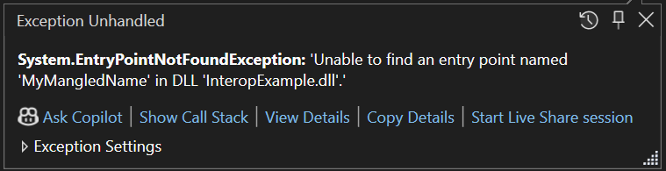
Make Mistakes, It’s Part of Learning
Notes:
Making Mistakes is OK
So, our first few ran successfully, but it looks like we have an exception when trying to invoke ‘MyMangledName’.
So why can’t we our library loader find this method and what can we learn from this?
PAUSE A MOMENT, THEN CLICK TO SHOW EXCEPTION MESSAGE
Well - as the method name implies - the name has been “mangled” by the compiler. Name mangling is one of the many pitfalls to look out for when implementing C#/C++ interoperability. Luckily, there is an easy fix for this.
NEXT SLIDE

Slide 9
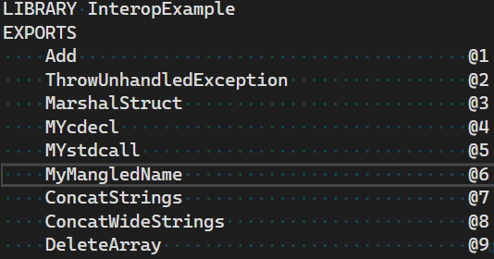
Mangled Method Signature
Mangled Method Signature
Unmangled Method Signature
Use extern “C” or a module definition (.def) file to avoid name mangling
Notes:
Mangled Method Signature
Very briefly, exported C++ method names will be “mangled” to allow for method overloading - a feature of C++ which allows for methods to share names but have a different parameters.
On the screen here you can see the difference between a mangled method name (top), and one that is not mangled (bottom).
CLICK TO SHOW FIX
The reason this method name was mangled is because we declared it outside the scope of our `extern “C”` directive. Declaring the method within the `extern “C”` directive or specifying a module definition file will avoid this issue. For the rest of this presentation, I will compile using the build configuration which includes the module definition file.
NEXT SLIDE

Slide 10
Our Console Application
Notes:
Our Console Application
OK, so let’s go back to our console application and change the build configuration to one that uses the module definition file.
CLICK TO START VIDEO
So here’s our console app again; we’re just going to change the build configuration to “Debug”, which will utilize a module definition file to avoid our name mangling issue.
WAIT FOR SUCCESSFUL PROGRAM COMPLETION
And there you go! All of our interop methods ran successfully, including our method which previously encountered an error due to name mangling.
WAIT FOR VIDEO TO END
NEXT SLIDE

Slide 11

Challenges & Pitfalls
Type Marshalling
Memory
Exception Handling
Operating Systems
Notes:
Challenges & Pitfalls
So we’ve already seen one example of some of the challenges we might face when using interop - with our “name mangling” issue - so what are some other things we might face?
Memory management. Often times you may need to pass complex types across the interop boundary. In these cases, you’ll have to keep track of what objects are allocated in .NET and managed by .NET’s garbage collection, and which objects are allocated in native code and may need to be cleaned-up manually.
Type marshalling. Real-world use-cases will usually require custom type marshalling to “translate” your objects between a type compatible with C++ and a .NET-compatible type. This can increase the complexity of your code and make debugging more difficult.
Exception handling. Unhandled native exceptions are not allowed in your interop methods. Thus it is necessary to catch user exceptions in C++ before they reach the interop boundary and instead use a return value to indicate success or failure.
Operating systems. Since C++ compiles to native machine code, you must compile and deploy a separate native assembly for every unique platform you wish to support (e.g. Windows, MacOs, Android, etc.). This can greatly increase the complexity of your software especially in regards to testing and deployment.
NEXT SLIDE

Slide 12
Marshalling Unicode Strings
String Encoding (By Platform)
 | Windows | Unix
C++ (std::wstring) | UTF-16 | UTF-32
C# | UTF-16 | UTF-16
Marshalling | BSTR struct | BSTR struct
Potential Strategy to Avoid Encoding Headaches
Convert string to byte array in .NET, using a UTF-8 encoding
Pass string to C++ as UTF-8 byte array
Convert byte array to wide string using `std::wstring_convert`
Notes:
Marshalling Unicode Strings
Next, let’s look at a couple of different types which require special care when using them as parameters in your interop methods, starting with strings. String encoding is another thing we often take for granted in .NET. When marshalling unicode strings, we must be careful to consider potential platform differences. There are a lot of different strategies for handling unicode strings in interop, and here I will just outline one potential strategy.
CLICK TO SHOW STEPS
First, get the bytes of your string in .NET, encoded as UTF-8
Pass the byte array as an interop parameter
Convert to byte array back to platform-dependent wide string in C++ using `std::codecvt`
NEXT SLIDE

Slide 13
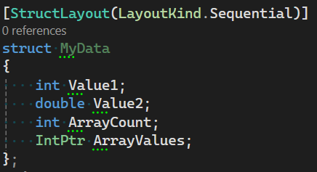
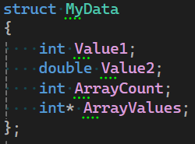
Marshalling Structures
C++
C#
Struct layouts must match exactly!
Notes:
Marshalling Structures
Eventually, as the complexity of your program grows you may want to start marshalling more complex types. Using structs in your interop methods will help reduce parameter count, reduce boilerplate code, and promote reusability.
Some points to remember when marshalling structures:
Structs can contain arrays, which should be passed as an IntPtr
Structs can contain other structs, which should also be passed as an IntPtr
Keeping structs definitions in sync requires vigilant and defensive coding practices
You can catch layout mismatches using hash codes, version numbers, or struct sizes
When working in a team, consider implementing processes to guard against layout mismatches, such as assigning a code owner to any files which define struct layouts
NEXT SLIDE

Slide 14

Celebrate Your Successes
Notes:
Reflect
So far we’ve covered how to export methods in C++ so they can be called in .NET, how to call those methods from .NET using either the `DllImport` attribute or the `NativeLibrary` class, and some strategies for marshalling structs and unicode strings. These topics provide the basic building blocks for building a .NET application or library with C++ interop support, but we’re not done yet. Next we’ll cover a few more topics to help you transition your proof-of-concept into product-ready code.
NEXT SLIDE

Slide 15
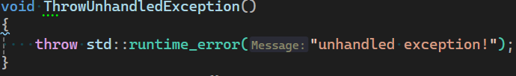
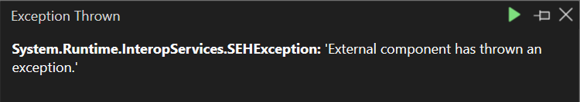
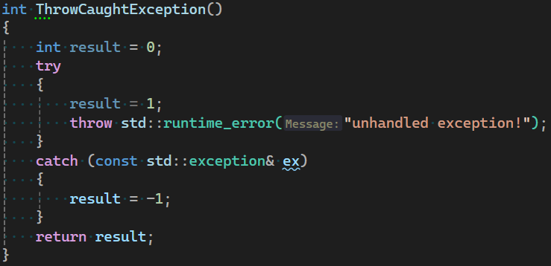
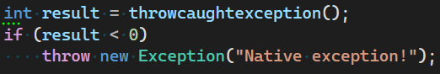
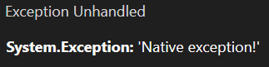
Error Handling
Unhandled Native Exceptions Always Throw ‘SEHException’
Use Return Values to Indicate an Error
C++
C#
Notes:
Error Handling
Unhandled C++ exceptions must not be allowed to reach the interop boundary. Doing so will always result in an `SEHException` which lacks the original exception message.
CLICK TO SHOW FIRST STEP
To remedy this, we can wrap all of our C++ interop methods in try/catch clauses and use return values to indicate success or failure. CLICK TO SHOW SECOND STEP We can then check these return values in .NET and then throw a more appropriate error message, if necessary.
CLICK TO SHOW THIRD STEP
If the return value indicates a failure, we could optionally implement a way to retrieve the original exception information via interop, if necessary.
NEXT SLIDE

Slide 16
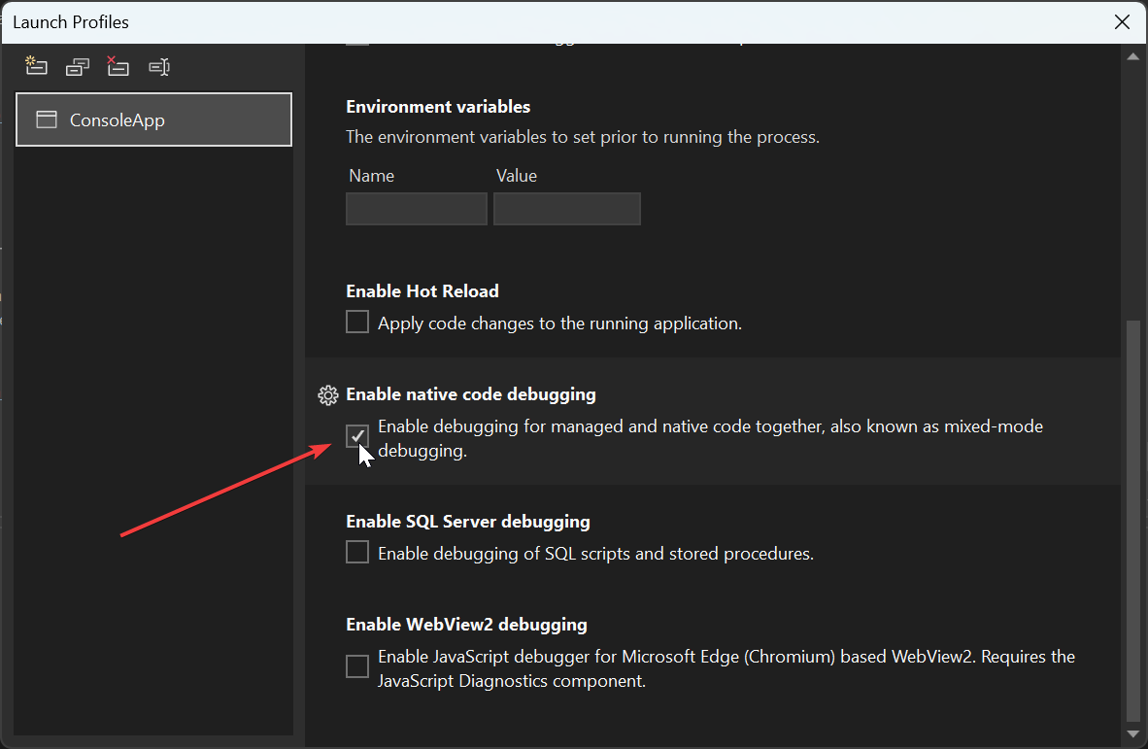
Debugging Native Code in .NET
Notes:
Debugging
In order to reach breakpoints in native code while executing a .NET application, we must enable native code debugging.
Right click your .NET project in Visual Studio and select properties
Navigate to the debug tab and select Open debug launch profiles UI
In the launch profiles window, check the box which says Enable debugging for managed and native code together
Vwa-la, you can now set breakpoints in C++ and reach them while attached to your .NET process.
NEXT SLIDE

Slide 17
Debugging Native Code in .NET
Notes:
Debugging Native Code in .NET
Let’s briefly get back into visual studio one more time and see what it might look like to hit a breakpoint in our native code.
START VIDEO
I’m going to navigate to our Interop.cpp file in our C++ project and set a breakpoint in the interop method for concatenating strings… WAIT FOR BREAKPOINT TO HIT
And here we are hitting the breakpoint, and we are able to inspect local variables as well as get a stack trace that spans both native and managed code. WAIT FOR VIDEO TO END
Note that you may also need to disable optimizations in your C++ project in order to ensure you can inspect local variables.
NEXT SLIDE

Slide 18
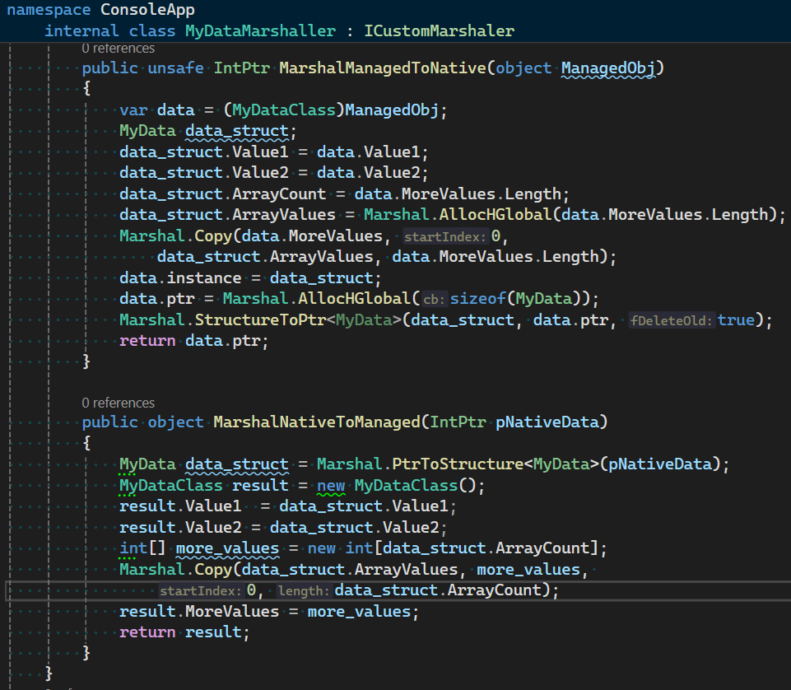
Reducing Boilerplate Code Using ICustomMarshaller
MarhsalManagedToNative
Copy class values into a struct
Retrieve unmanaged pointer for struct
MarshalNativeToManaged
Cast unmanaged pointer to struct
Copy struct values to class
Notes:
Using ICustomMarshaller
You may notice that C#/C++ interoperability requires quite a bit of boilerplate code. Luckily, .NET provides us with `ICustomMarshaller` to help enable marshalling of complex types and reduce boilerplate code.
Remember the custom struct marshalling we covered earlier? Let’s implement a custom marshaller to help streamline the marriage between our .NET class and the native memory pointer which is passed to native code.
CLICK TO SHOW IMAGE
Let’s briefly cover two of the methods we need to implement from .NET’s ICustomMarshaller interface.
CLICK TO SHOW FIRST SECTION
For the `MarshalManagedToNative` implementation, we need to first copy our class values into a struct, and then retrieve an unmanaged pointer to that struct. Note that we need to be sure to cleanup this pointer when we’re done using it.
CLICK TO SHOW SECOND SECTION
For the `MarshalNativeToManaged` implementation, we need to first “cast” our native pointer to a struct, and then instantiate our class using the values held within the struct. Note that this is pretty rudimentary implementation of a custom marshaller, and you can utilize some other aspects of .NET to make your life easier here. For example, you could use the `IDisposable` interface to help ensure your unmanaged memory gets cleaned-up, and you could utilize interfaces or implement implicit conversions to cast between internal interop structs and your publicly exposed class.
NEXT SLIDE

Slide 19
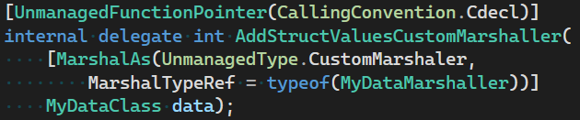
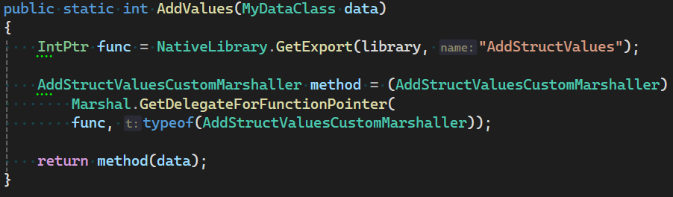
Reducing Boilerplate Code Using ICustomMarshaller
Function Delegate
Simpler Invocation
Notes:
Using ICustomMarshaller
And going back to the interop delegate declarations and invocation…
CLICK TO SHOW ARROW
…we can now see that invoking the interop method using a custom marshaller looks a lot cleaner, as we can just pass our class directly to the interop delegate.
WAIT A MOMENT
NEXT SLIDE

Slide 20

IRONPDF
Convert HTML to PDF in .NET 8, 7, 6, Core, & Framework
Generate PDFs in C# using HTML, MVC, ASPX, & Images
Sign, Edit, and Read PDFs with 50+ Features
Install & Deploy in minutes with NuGet
https://github.com/djrecipe/DotNetConf2024CppInterop
Notes:
Iron Software
Alright, today we’ve covered how to implement C++ interop into your .NET application using the `NativeLibrary` class, some considerations when writing your C++ header files, how to marshal strings and structs, and how to bring your app into production using proper error handling and more advanced type marshalling techniques.
A lot of these details regarding interop are things I’ve learned while iterating on our software as the lead developer of IronPdf over here at Iron Software. There is a public github repository available with all the code we went over, and I’ll go ahead and drop a link to the repo under the youtube video after it goes live. I hope some of you find this helpful, thank you all for you time.

